Slide 1
Auto Calibration of HELIOS Data

Slide 2
The Problem
Difference detector has difference gain, or MeV-to-channel
Manual or Semi-Manual method
Flatten e’ = a*z - e
Automatic method
Compare e with e_sim
(least square method)
Manually to find a
Set correlation = 0
Compare e’ for difference detectors

Slide 3
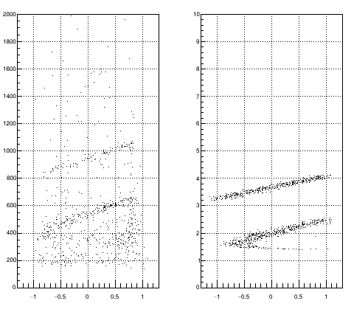
Idea
Exp
Sim
Since the e-z plot is completely determined by kinematics
We can “map” the experimental plot to simulated plot
Challenge -- noise
Noise

Slide 4








Algorithm
Pick a point in experimental data,
Scale the energy,
Find the point in simulation data,
So that is minimum.
Obtain = Sum of all D.
Find the (a,b), so that is minimum.
Monte Carlo Search
$$\vec{r_{i}}=(x_{i},e_{i})$$
$$\vec{R_{i}}=\left(x_{i},e_{i}^{′}\right), e_{i}^{′}=\frac{e_{i}}{a}+b$$
$$\vec{A_{j}}=\left(X_{j},E_{j}\right),$$
$$D_{i}={\left|\vec{R_{i}}−\vec{A_{j}}\right|}^{2}, ∃j$$
$$D_{i}>D_{threshold}→D_{i}=D_{threshold}$$
the threshold can discard the noise
$$∑D_{i}$$
Speed up trick: Sampling data.
$$∑D_{i}$$
User define parameters:
$D_{threshold}$ = 0.02
$e_{threshold}$
Search range for (a,b)
Monte Carlo trial

Slide 5
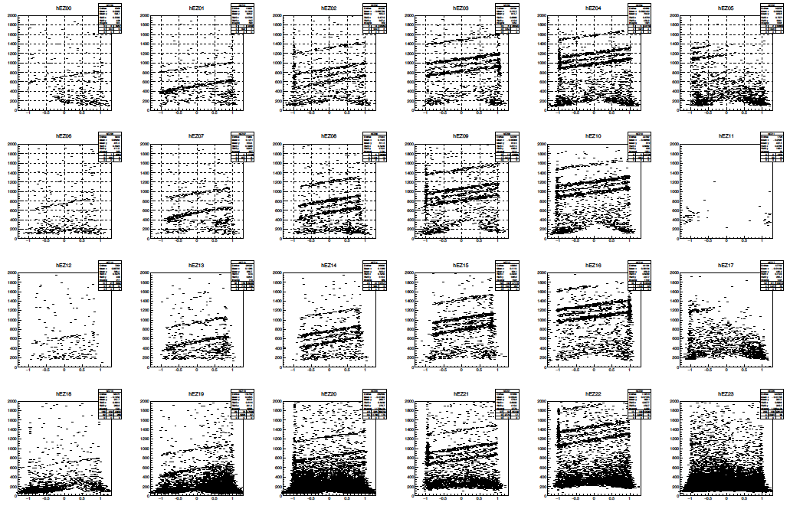
Experimental Data

Slide 6
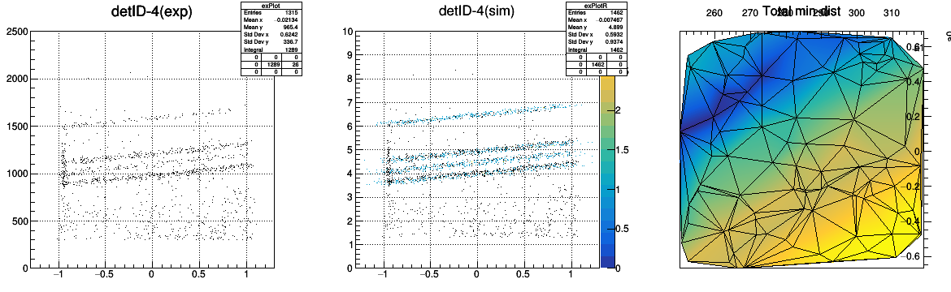
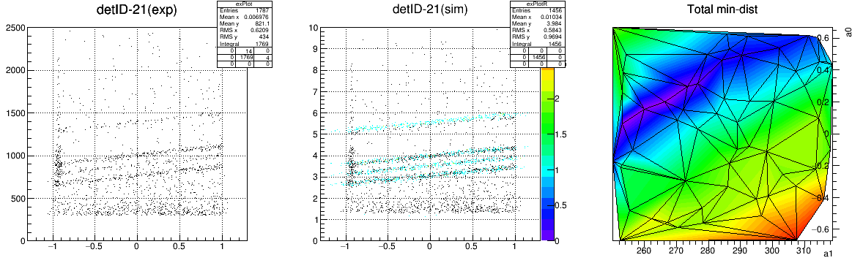
runtime: ~ 6 mins,
~ 300 data point for experimental data
~ 200 data point for simulation data
#Monte Carlo trial = 60
e_{threshold} = 300
Slightly misaligned

Slide 7
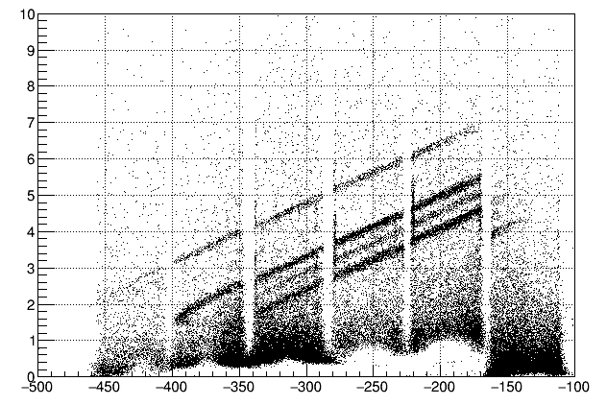
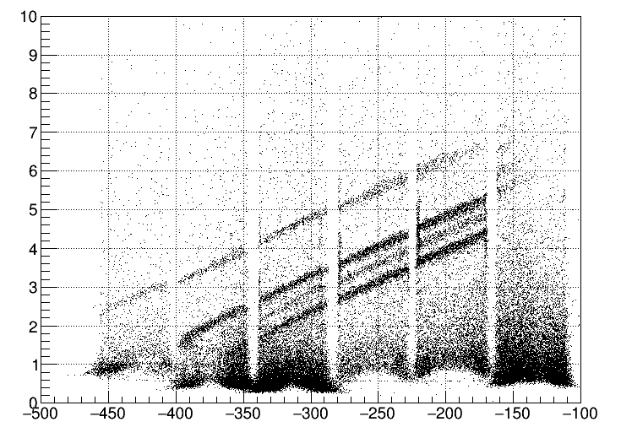
Result – (e-z plot)
The resolution is not as good as Manual.
The scaling parameters are not the same for each detectors → the resultant slope of the e-z lines are not identical
Manual Calibration ( ~ few days)
Auto Calibration ( ~ few hours)

Slide 8
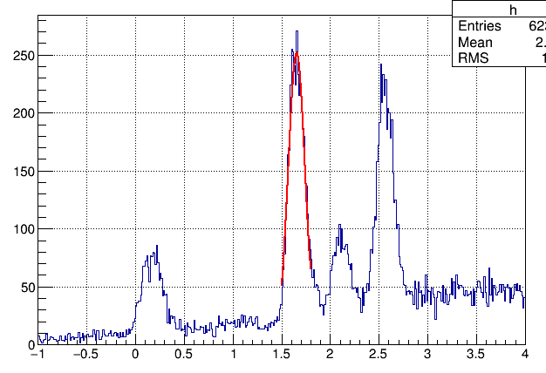
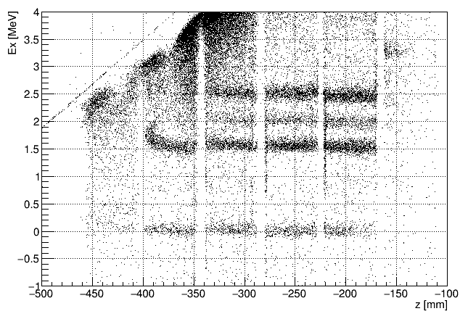
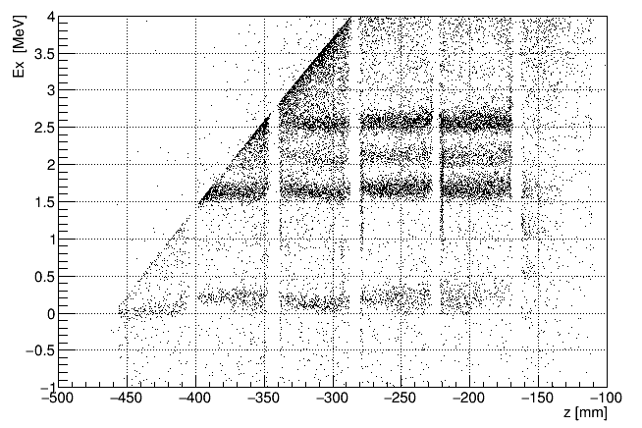
Result – (Ex-z plot)
Poor resolution: sigma = 100 keV
Not accurate
Strength the data for small thetaCM !
Cut when solving ( e,z) to (Ex, thetaCM)
If manual-Cali is using (e,z) to (Ex, thetaCM) mapping, could be improved.

Slide 9
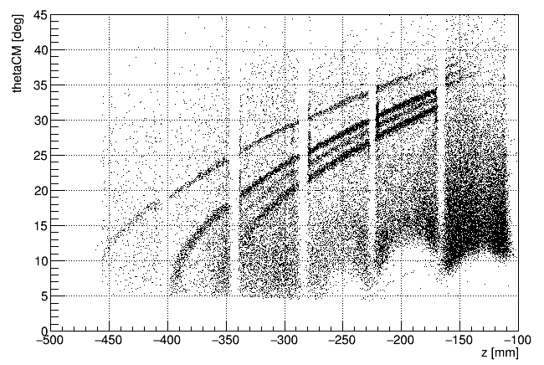
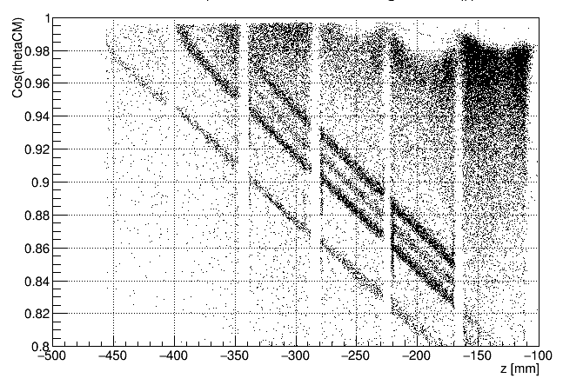
Result – (Cos(thetaCM)-z plot)
If manual-Cali is using (e,z) to (Ex, thetaCM) mapping, Cos(thetaCM) could be done.

Slide 10
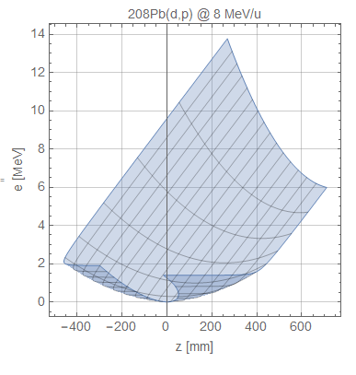
Advantage
Minimum Labor.
Require a simple survey on the data before calibration.
No need to cut out low thetaCM.
auto-cut when “folded”
Disadvantage
Folded
Larger resolution
At least 2 levels is needed.
The range of (a,b) can be difficult to find.

Slide 11
Future improvement
Find a method to fit same-pos detectors all together
So that the scaling factor is the same , 1+4-dim search, #trial ~ 3 order more
→ improve resolution
Better searching algorithm (machine learning?)
→ faster
Will the fit is better if simulation has no energy loss?
→ improve accuracy
A better mapping from (e,z) to (Ex, thetaCM)?
→ push the thetaCM to 0 degree?

Slide 12




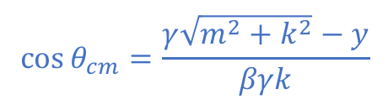
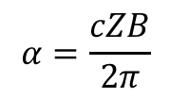


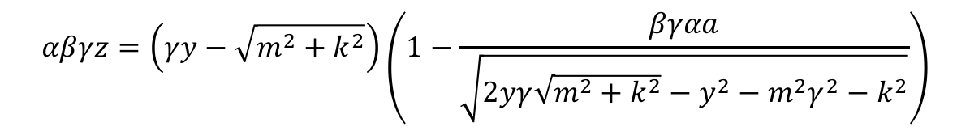











(e,z) to (Ex, thetaCM) map
$k$ = momentum of b or B in CM frame
$m$ = mass of proton
$$αβγz=\left(γy−\sqrt{m^{2}+k^{2}}\right)\left(1−\frac{βγαa}{\sqrt{2yγ\sqrt{m^{2}+k^{2}}−y^{2}−m^{2}γ^{2}−k^{2}}}\right)$$
$β$ = beta for center of mass 4-vector
$$y=e+m$$
Solve for $k$
$$α=\frac{cZB}{2π}$$
The equation can be reduced to the form
$a$ = radial distance of the axis to detector
$$Z=αβγz$$
$$Z=H\sin{φ}−G\tan{φ}$$
$$G=αβγa$$
Solve for $φ$
$$H=βγ\sqrt{y^{2}−m^{2}}$$
$$k=H\sin{φ}$$
$$E_{B}^{2}=m^{2}+E_{t}^{2}−2E_{t}\sqrt{m^{2}+k^{2}}$$
$E_{t}$ = total energy in CM frame
$$E_{x}=E_{B}−m_{B}$$
$E_{B}$ = total energy of recoil particle in Lab frame
$$\cos{θ_{cm}}=\frac{γ\sqrt{m^{2}+k^{2}}−y}{βγk}$$
$m_{B}$ = mass of recoil particle

Slide 13
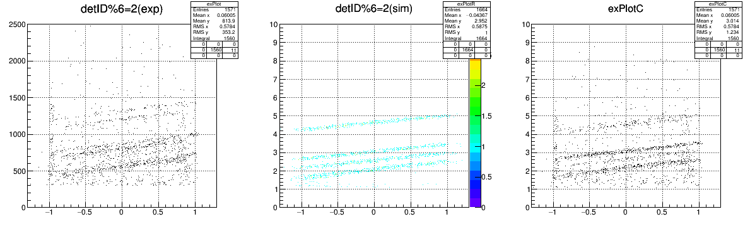
Update – share scaling
Only use detID = 2, 8
Run for 14 min for 60 trial. 781 used.

